Slide 1



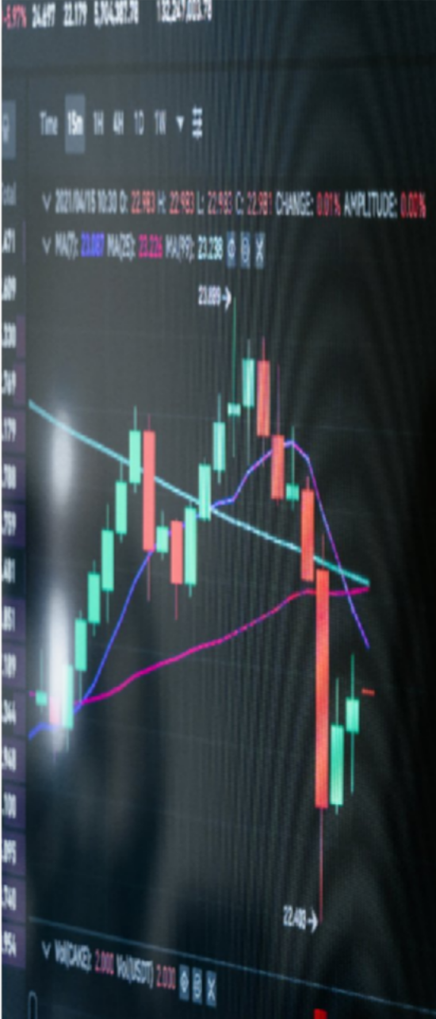

AI &ML
PBL REVIEW - 4
Predicting Daily
Stock Price
Changes

Slide 2
WHAT IS THE STOCK MARKET?

Slide 3



LITERATURE
SURVEY
Buchelier (1900) first proposed the idea of modeling stock price changes using normal distributions.
Samuelson (1965) refined this model, introducing the concept of Geometric Brownian Motion, which assumes that logarithmic
returns follow a normal distribution.
Mandelbrot (1963) highlighted that real market returns sometimes
have “fat tails,” meaning extreme price changes occur more
frequently than Gaussian theory predicts.
Despite these findings, Gaussian modeling remains a foundational approach because of its simplicity and mathematical
tractabilit

Slide 4





HOW STOCKS ARE TRADED
Trading Platforms
Investors buy and sell through licensed brokers
or digital trading platforms.
Order Execution
Transactions are processed electronically,
where prices fluctuate based on demand and investor activity.

Slide 5
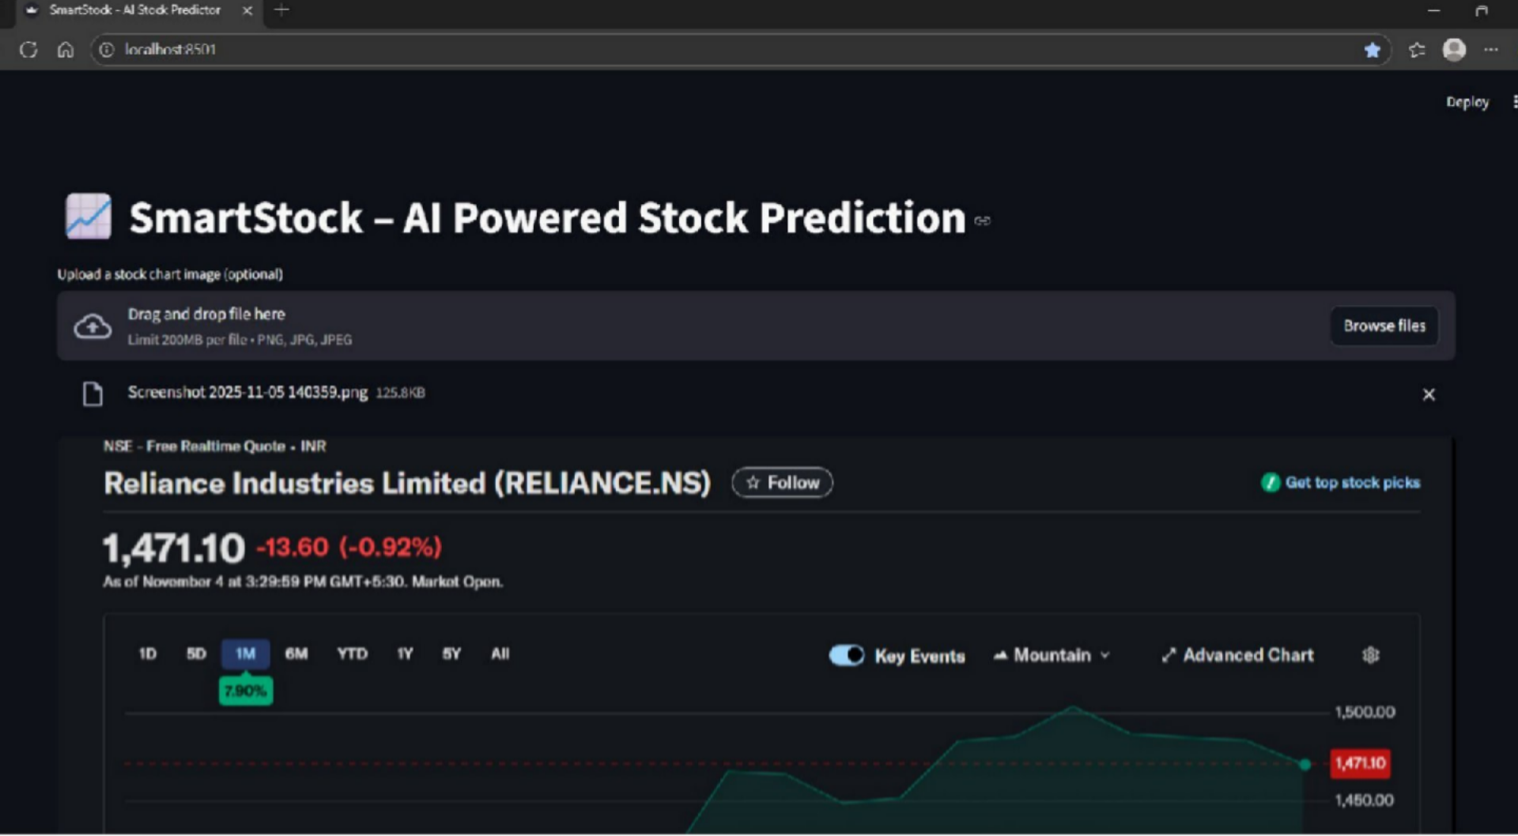

Slide 6
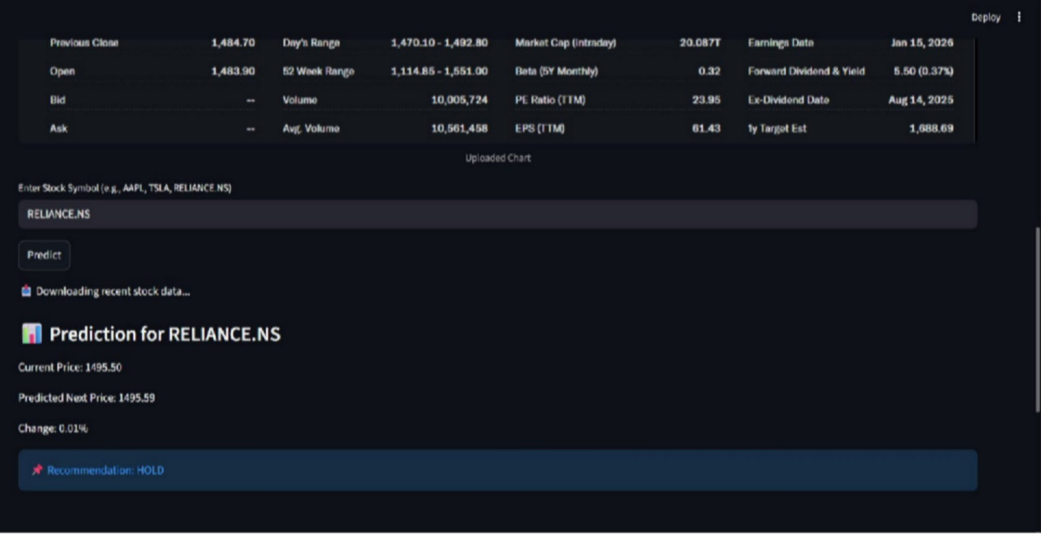

Slide 7




Team
2410040008 - T.sunny
2410040010 - M.Hemanth
2410040060 - C. Sai srikar 2410040067 - V. Gireesh 2410040072 - D.Sai prasad
THANK YOU

